Slide 1

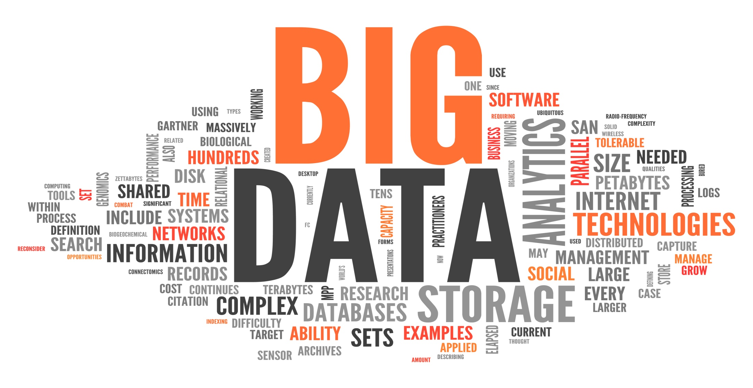
BIG DATA CHALLENGE - 1
BY
Syam Prasad Dokuparthi
Nitish Reddy Nalla
D Syam Prasad Dokuparthi
Nitish Reddy Nalla

Slide 2
DATA ACQUISITION
Data is downloaded data from http://api.nytimes.com with the combination of OFFSET and APIKEY.
OFFSET is varied by 20 every time to retrieve the data as there is limitation access only 20 data records at a time in nytimes API.
Data is parsed with JSON parser and Results are obtained from parsed data.

Slide 3
DATA ACQUISITION
From the Results data , URL and ABSTRACT is again filtered and written to a file.
Unique Data records are obtained with a HASH SET (checking URL for duplicate records).
Unique Key Identifier is added to every Record which is the line number where data is written to file.
40,000 records are captured exactly by checking with the Unique Key identifier value.

Slide 4
PREPOCESSING , TF-IDF
Data is preprocessed with cleaning the data by removing the Punctuations, numbers.
Stop words are removed with the help f google stop words.
Every word is converted to lowercase

Slide 5
PREPOCESSING , TF-IDF
Term frequency (TF) is calculated which is the count of the number of times a word appears in a document. This is Done in Mapper
IDF is calculated in reducer which is inverse of the number of times a word occurred in all the total number of documents where the word appeared uniquely. Reducer will take care of it.

Slide 6
CLUSTERING
For clustering we used K means algorithm as we find it as more generalised algorithm to cluster and very easy to implement the algorithm.
We could see that K mean algorithm is widely used Vector Quantiation, Cluster analysis, Feature Learning

Slide 7
K Means Clustering
Pros :
Easy to Design and Implement.
Simple to Understand and more generalised.
Minimum Local Error
Works well for round shaped ad of roughly equal sized or densed clusters
Cons:
Makes Hard assignment of points to clusters.
Median is more robust than mean in presence of outliers

Slide 8
K Means Clustering
Clustering is done with Apache Mahout and Matlab.
We considered the number of clusters as 15 since we say a best clusters centroid distribution with number of clusters as 15.

Slide 9
BIG DATA IN MATLAB
In Matlab 2014b New functions for processing big data that can scale for use with Hadoop were developed.
Clustering can be done in Matlab with K means function.

Slide 10
CLUSTERING IN MATLAB
In Matlab Clustering we can obtain
1.Cluster IDs.
2.Cluster centroid for k clusters in K-by P matrix.
3.With in Cluster sums of point to centroid distances in K by 1 vector
4.Distances from each point to every centroid in N by K matrix(where N is number of records).

Slide 11
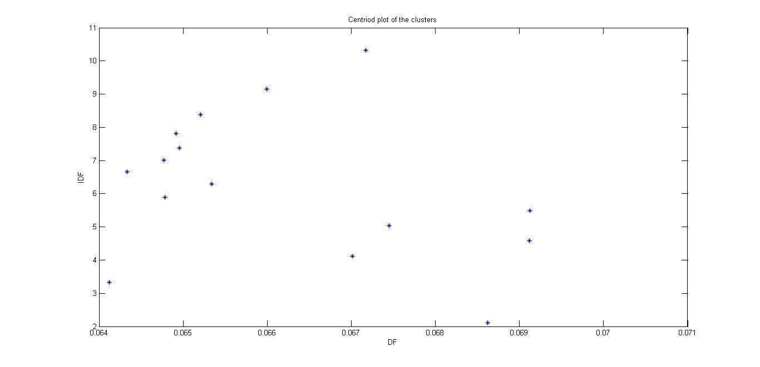
Centriod Plot of Clusters

Slide 12
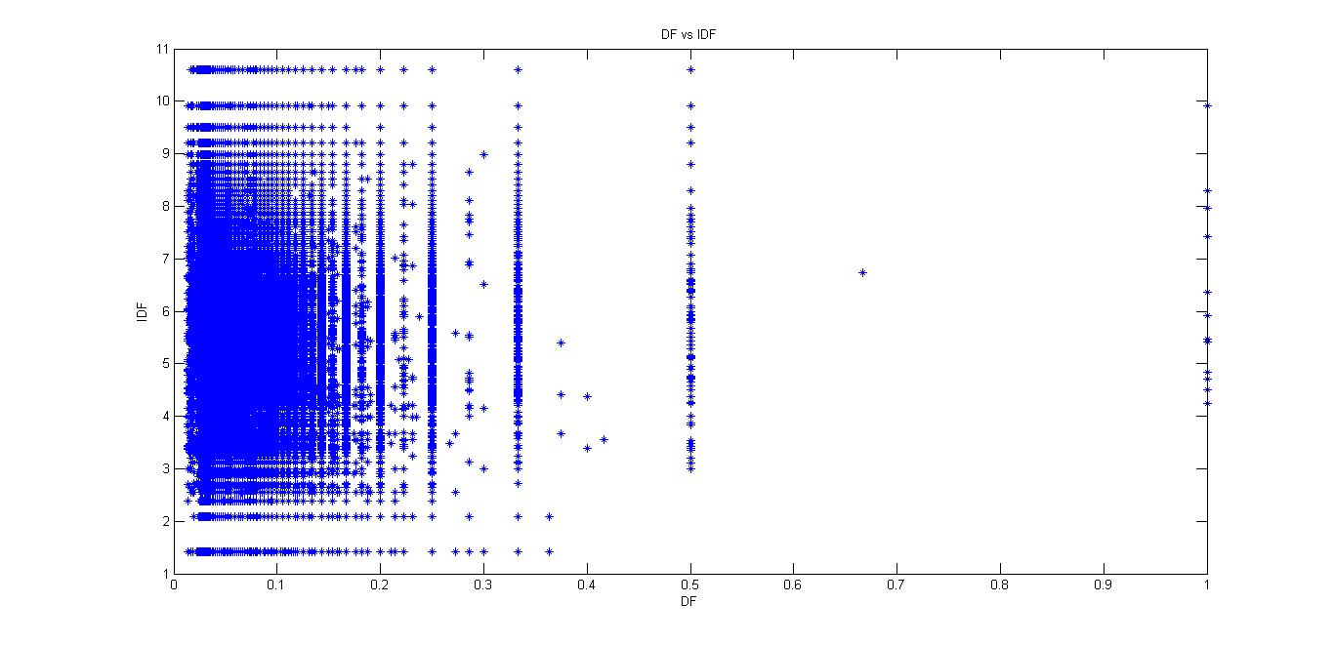
TF vs IDF plot

Slide 13
TOP 20 MOST DESCRIPTIVE
TERMS PER CLUSTER
(R STUDIO)

Slide 14
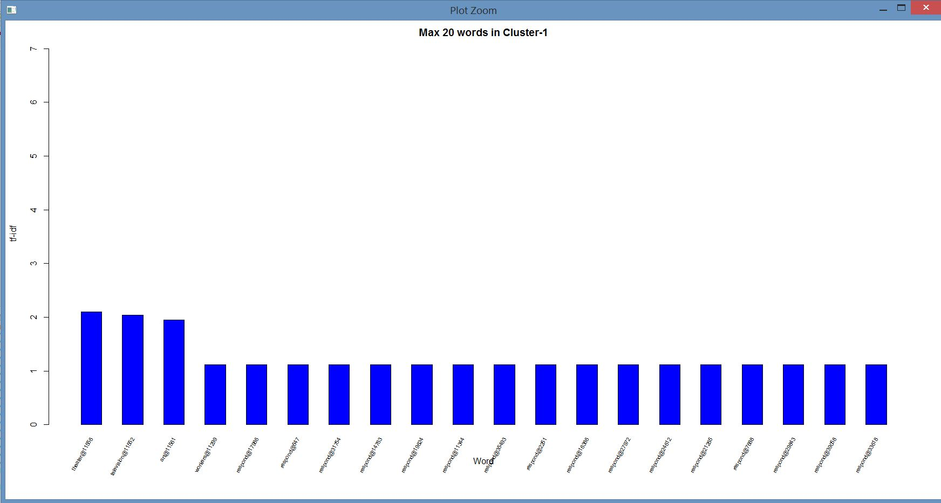

Slide 15
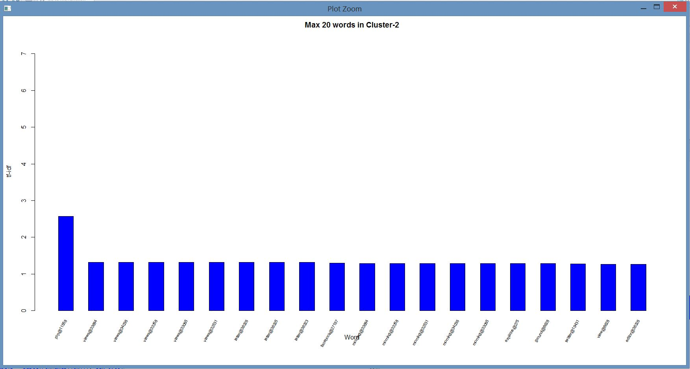

Slide 16
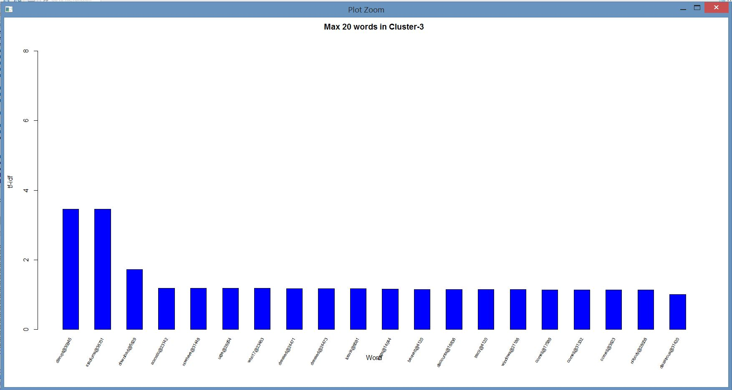

Slide 17
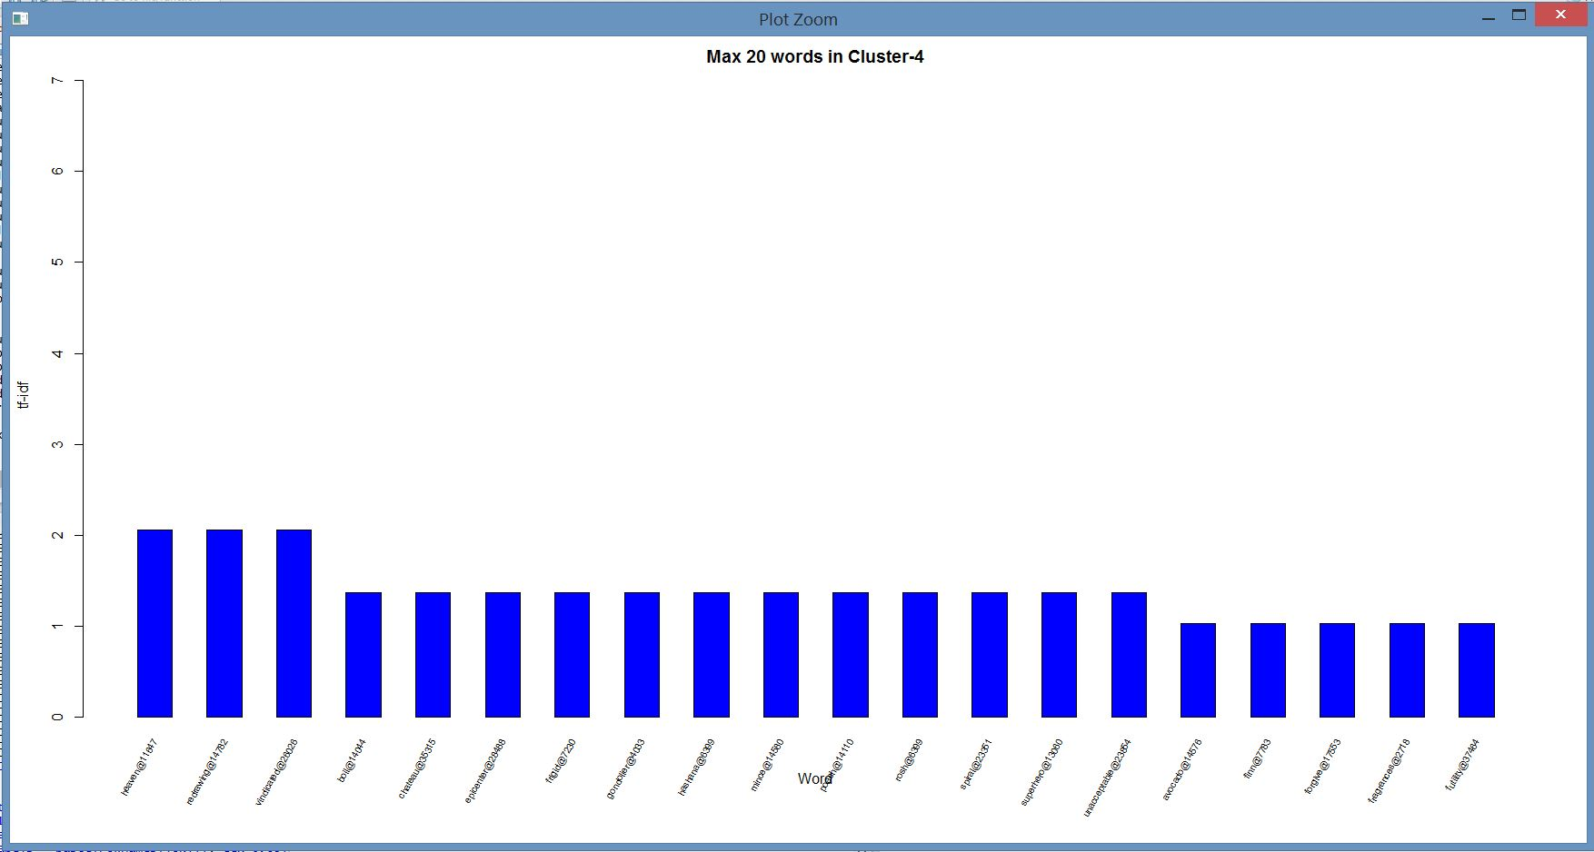

Slide 18
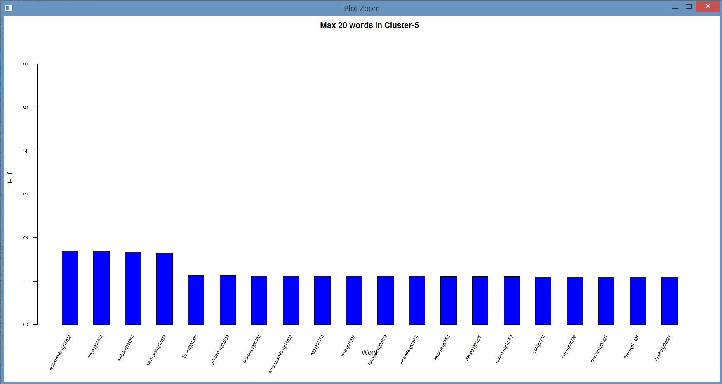

Slide 19
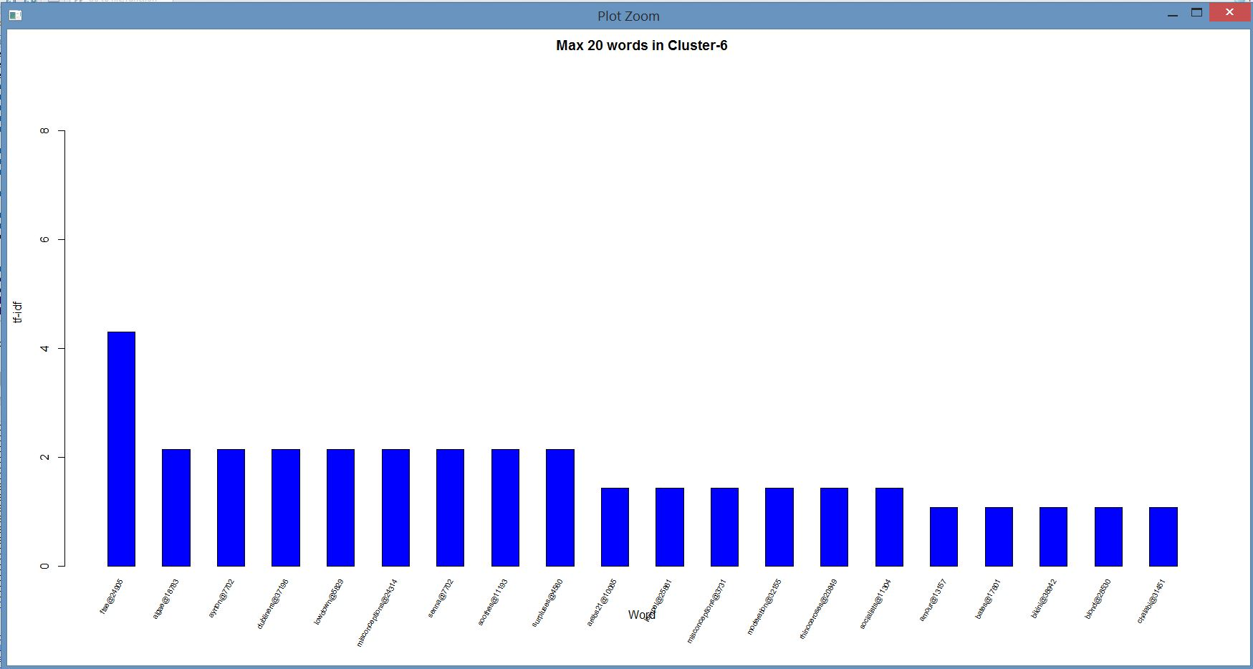

Slide 20
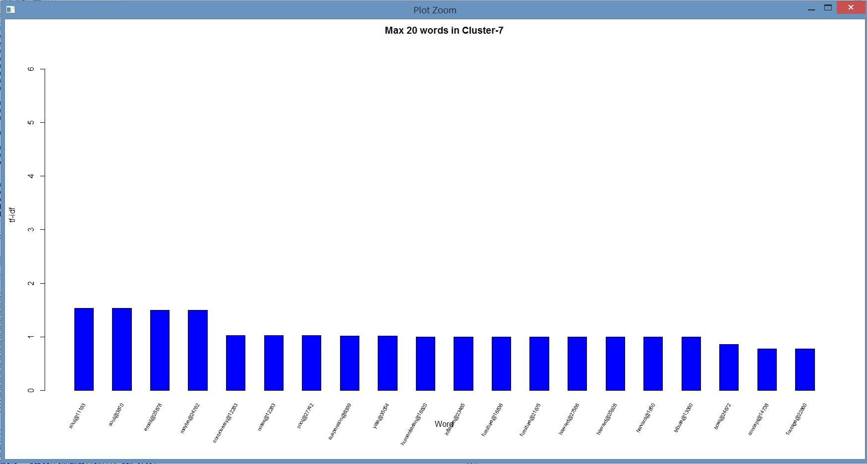

Slide 21
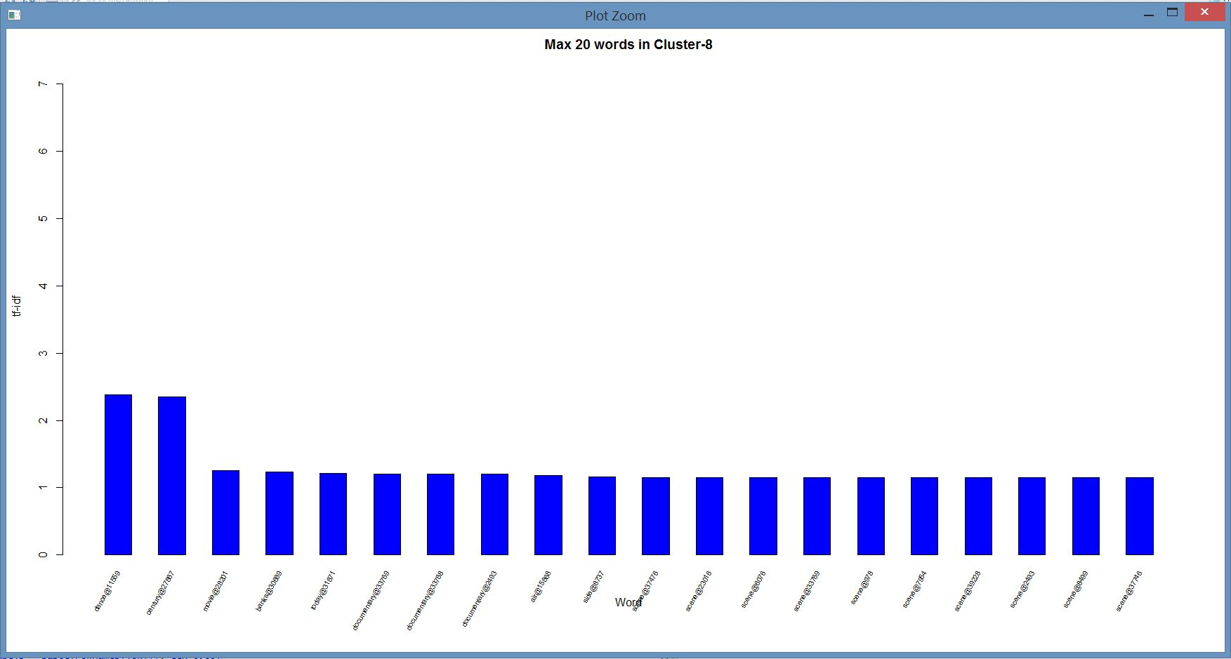

Slide 22
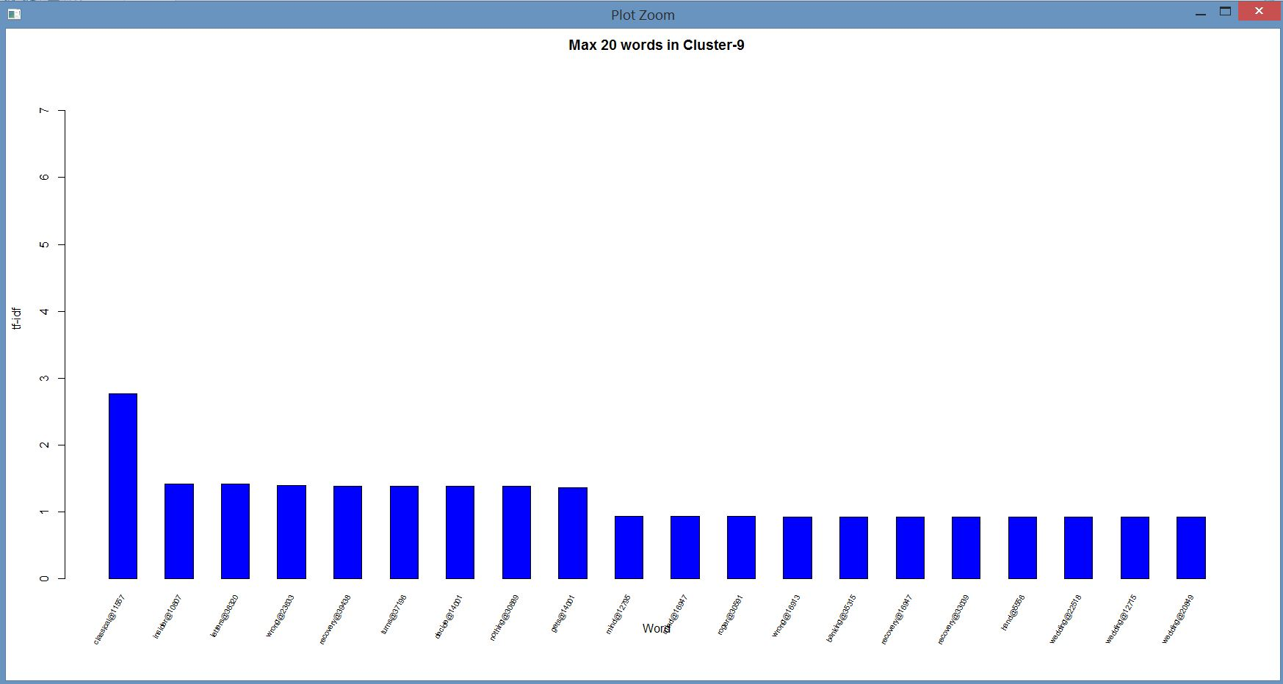

Slide 23
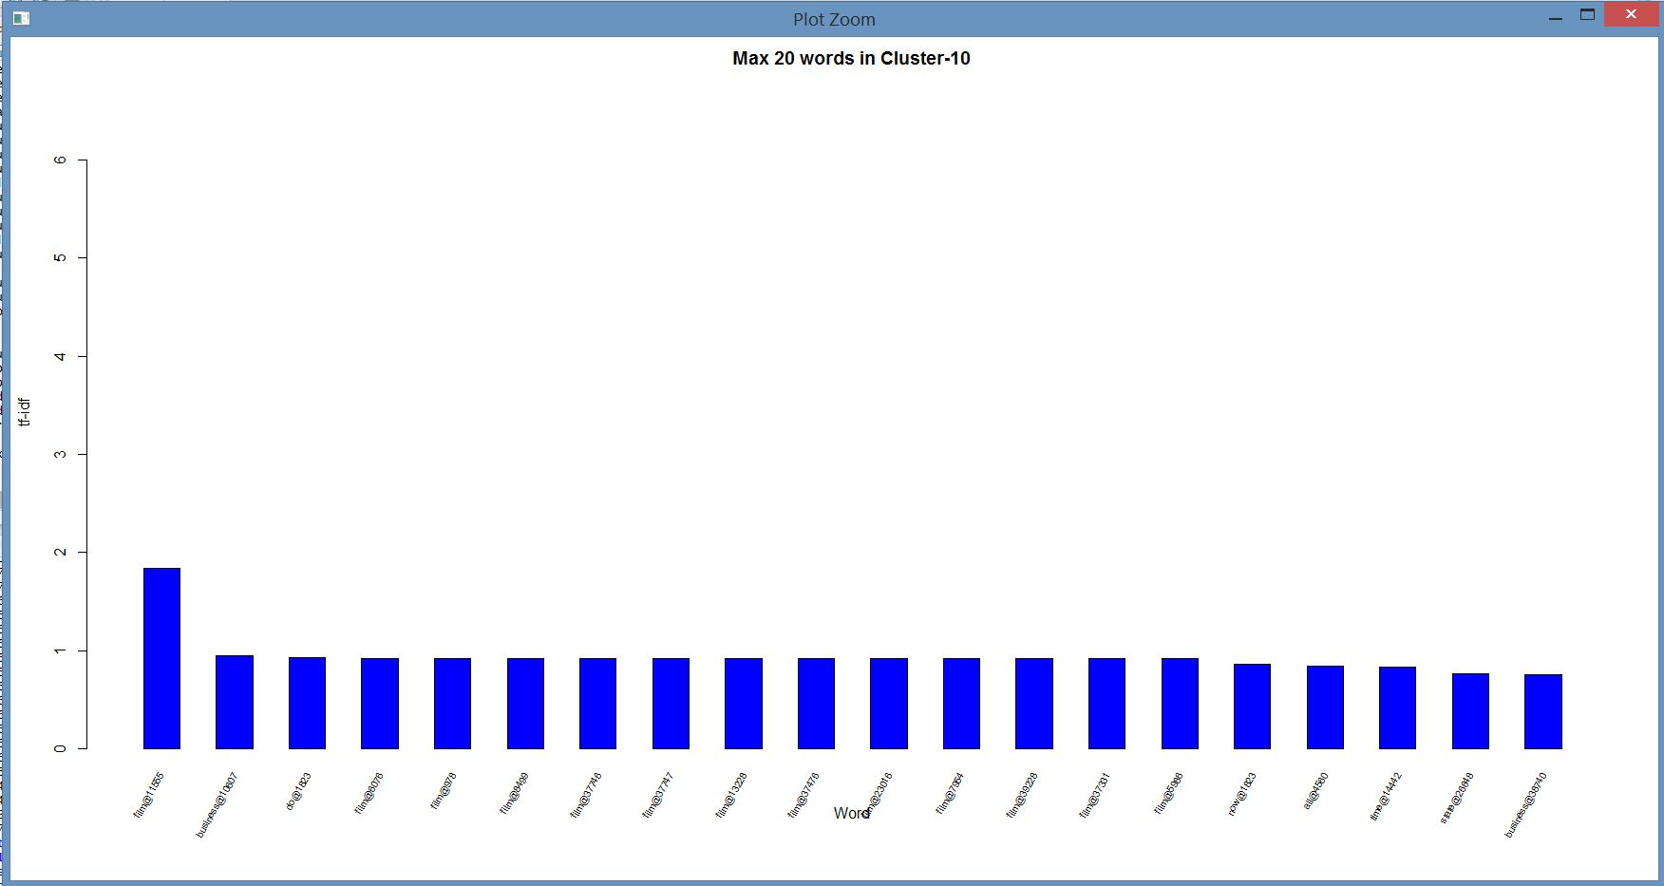

Slide 24
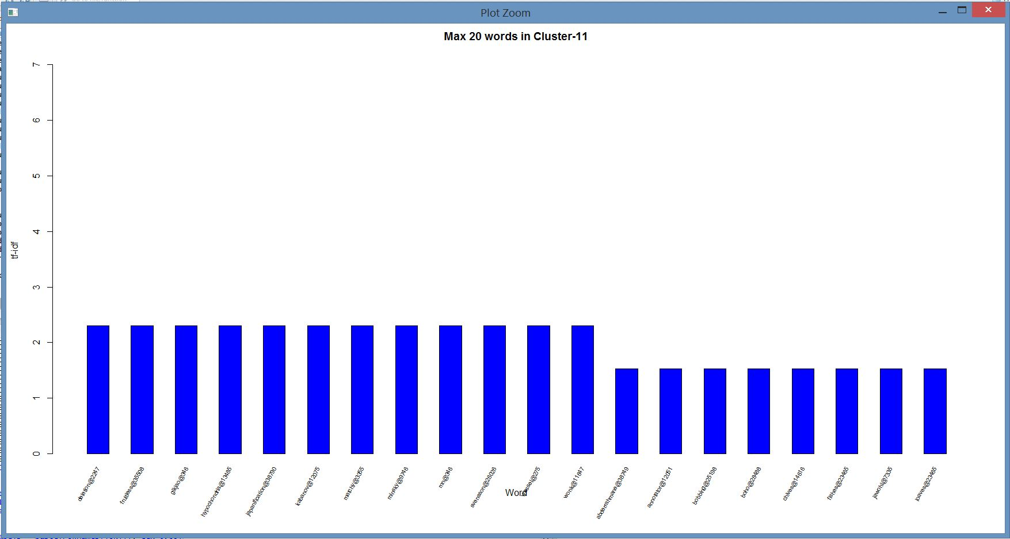

Slide 25
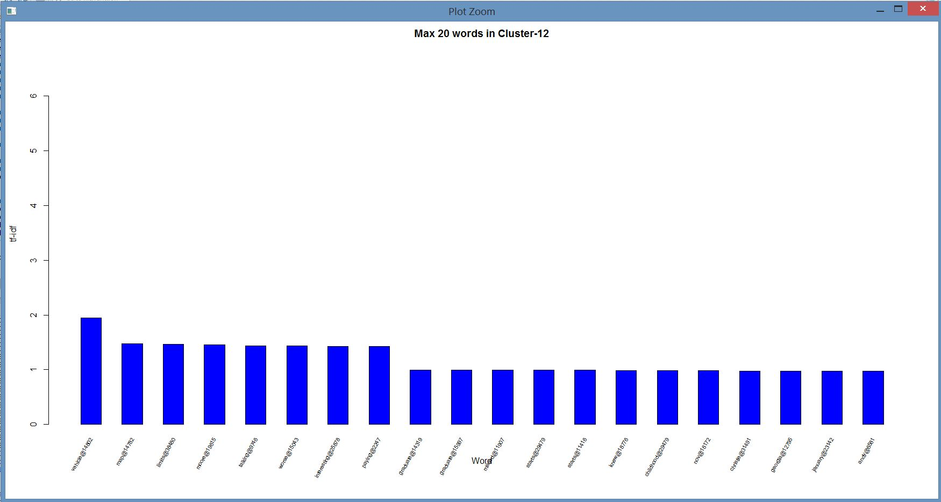

Slide 26
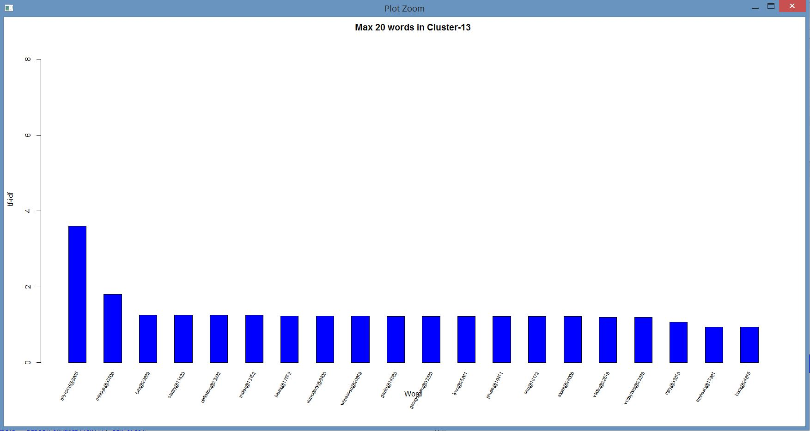

Slide 27
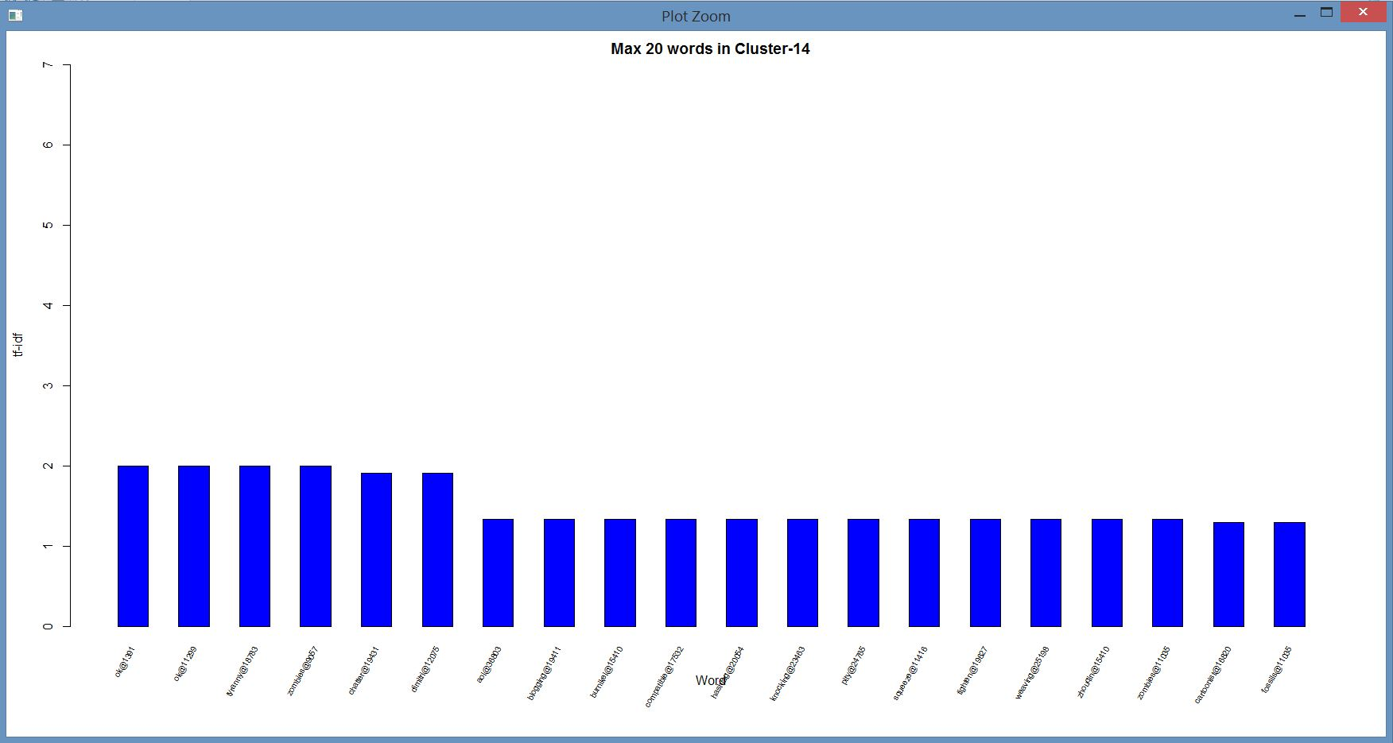

Slide 28
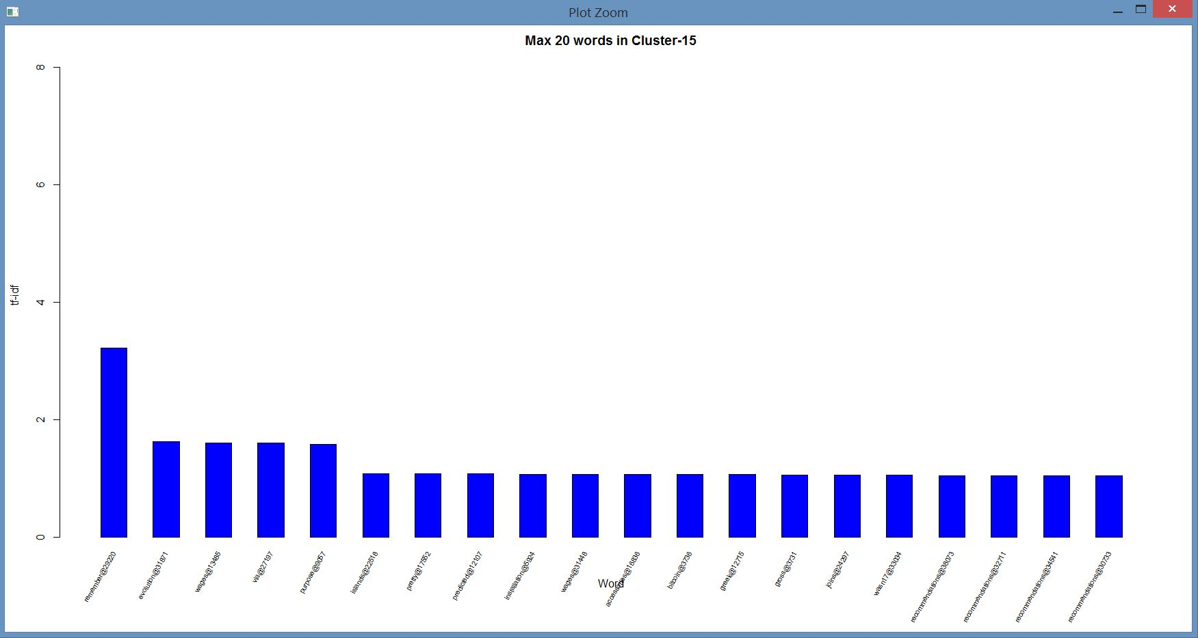

Slide 29
THANK YOU

